Slide 1
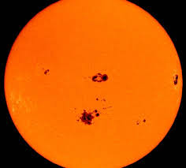

Sunspots Data
By Jonah Zembower
Notes:
I am looking at the sunspots dataset.

Slide 2

Sunspots Dataset
This dataset contains historical records of sunspots. Typical sunspot datasets include measurements such as the date of observation, sunspot numbers, and sometimes details about solar cycles. Such data is crucial for studying solar activity and its cycles over time.
Notes:
Here is the overall understanding of the dataset. Sunspots are dark, planet-sized areas on the sun's surface that are caused by intense magnetic fields. This dataset counts the total sunspots average for a month each month of the year for about 272 years.

Slide 3
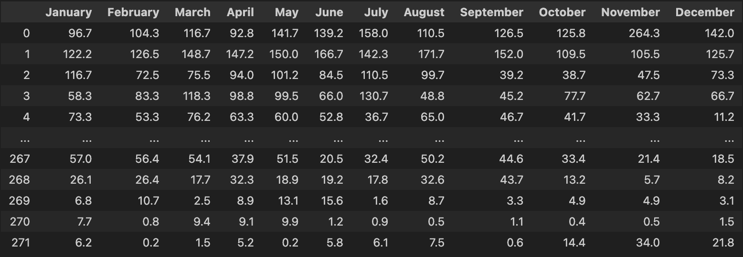
Creating a Data frame to Split into Monthly Values
Notes:
I will use this data frame to look at the mean, median, standard deviation, and variance for all these values of each month.

Slide 4
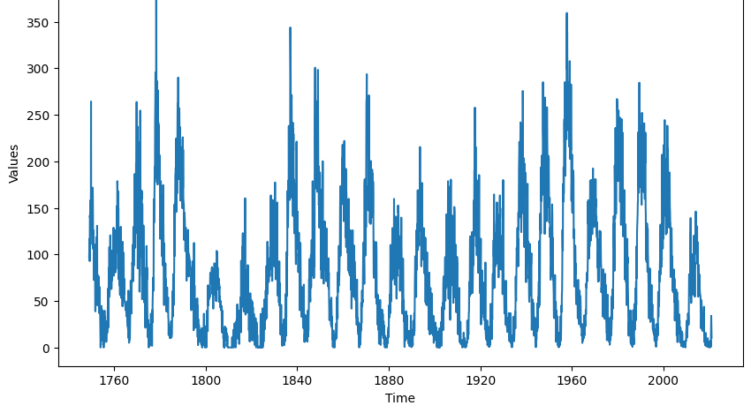
Looking at the Time Series of the Data
Notes:
The data exhibits a clear cyclical pattern, which is typical of sunspot activity over 11 years that are considered solar cycles.
The peaks and troughs in the graph represent the solar maximum (high sunspot activity) and solar minimum (low sunspot activity), respectively.
The graph spans over 240 years of observations, which allows for the study of long-term trends and changes in solar activity.

Slide 5
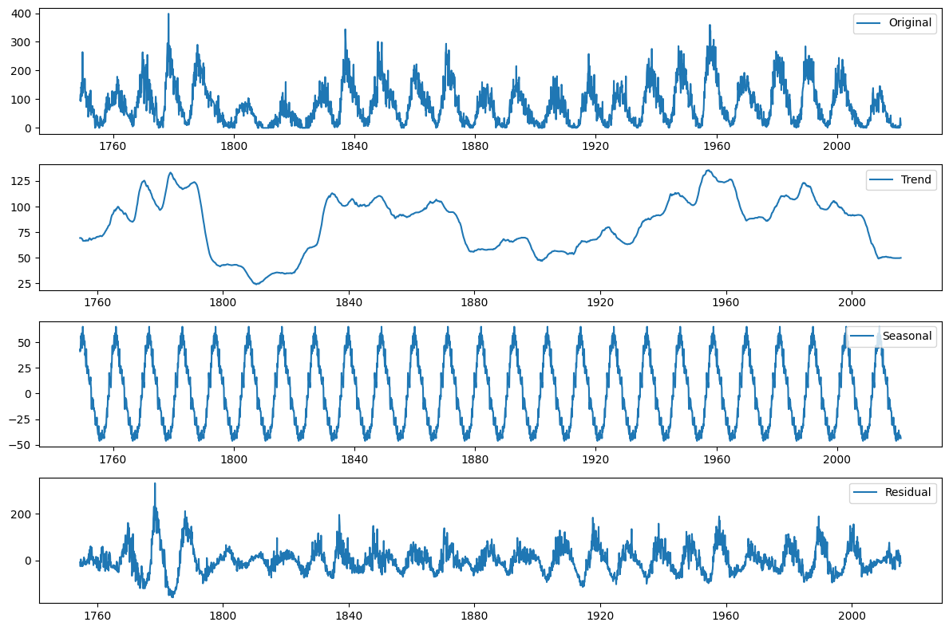
Seasonal Decomposition
The seasonal component aligns with the 11 year solar cycle.
Residuals appear mostly random without any discernible pattern.
Notes:
This seasonal decomposition was done over a cycle of 11 years continuously. We can clearly see that cyclical pattern. The residuals appear to have lesser meaning compared to the trend and cyclical components of the graph.
Some insights for the trend include an increase in activity up until around 1960. There is then a noticeable decline suggesting a potential long-term decrease in sunspot numbers or a shift in the cycle’s intensity. The overall trend helps identify periods of heightened or reduced solar activity, which are crucial for studying solar dynamics and their implications on space weather and terrestrial effects.

Slide 6
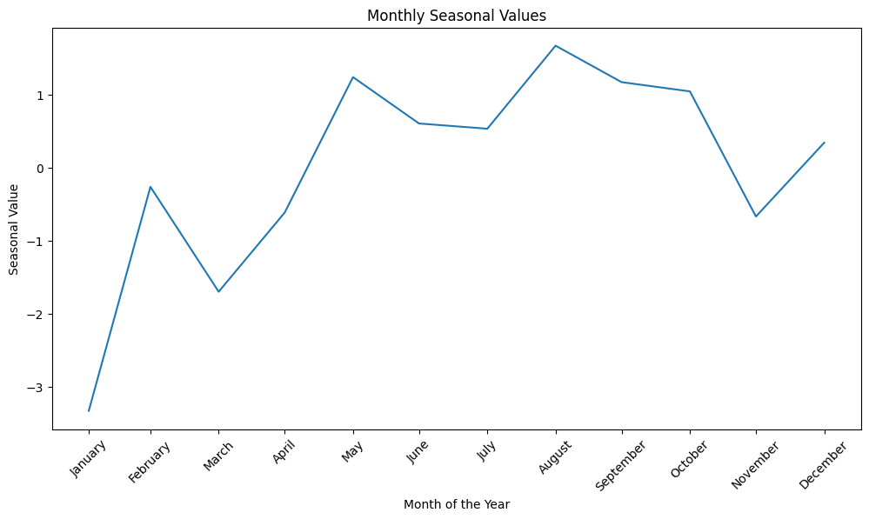
Looking at Monthly Values for a Year
General increase throughout the year in the trend.
Notes:
This shows an interesting trend for the seasonal values in one year, but there is still a clear period of 11 years overall that we will assess mostly.
There appears to be a capturing of the general increase for this specific year in the 11 year old solar cycle.

Slide 7
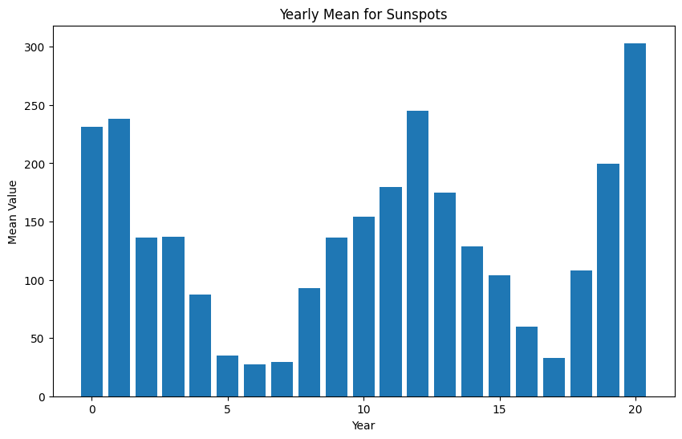
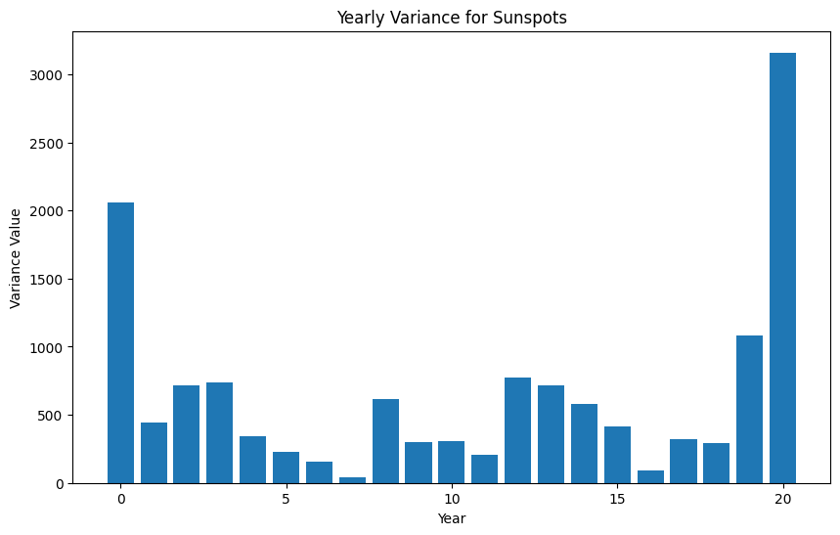
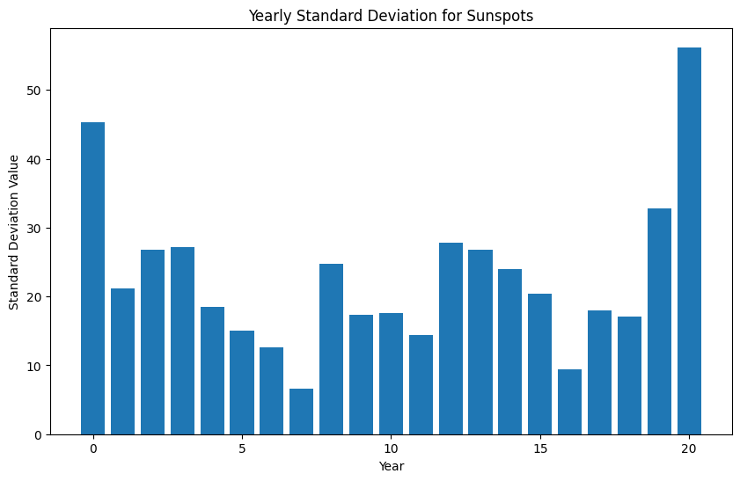
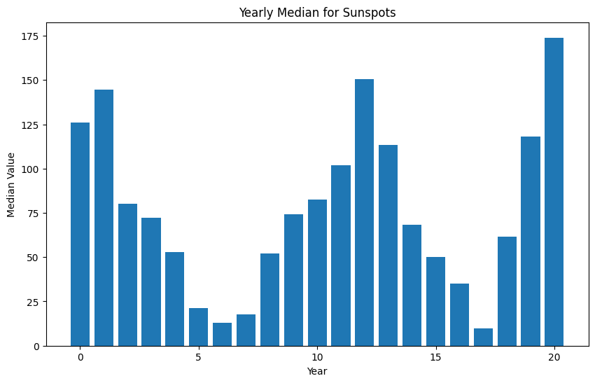
Looking at the Yearly Mean, Variance, Standard Deviation, and Median
Notes:
- The data exhibits clear cyclic patterns which are typical of the 11-year solar cycle affecting sunspot activity.
- The years with peaks in mean, median, variance, and standard deviation are likely those close to or at the peak of the solar cycle, when sunspot activity is more intense and variable.
- The increase in variance and standard deviation during peak years suggests not only more sunspots but also greater month-to-month variability in sunspot numbers.

Slide 8
Building the ARIMA Model
Components of Box-Jenkins Models:
p: Autoregressive (AR) order for non-seasonal component.
d: Differencing order for non-seasonal component.
q: Moving average (MA) order for non-seasonal component.
P: Autoregressive (AR) order for seasonal component.
D: Differencing order for seasonal component.
Q: Moving average (MA) order for seasonal component.
s: Seasonal period (e.g., 12 for monthly data, 4 for quarterly data).
Notes:
I will generate ACF and PACF plots for each dataset to identify potential AR and MA components. Then, I will fit different ARIMA and SARIMA models based on the insights from these plots and using criteria such as AIC and BIC to select the best model. It is important to remember that AIC selects a model that is most accurate in underlying mechanisms that generates the observed data. While, BIC aims to select the most true model based on certain assumptions.

Slide 9
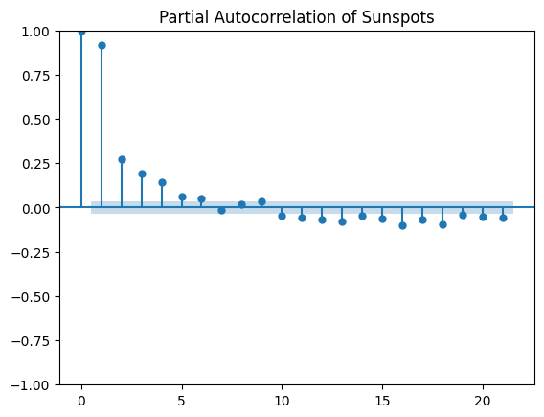
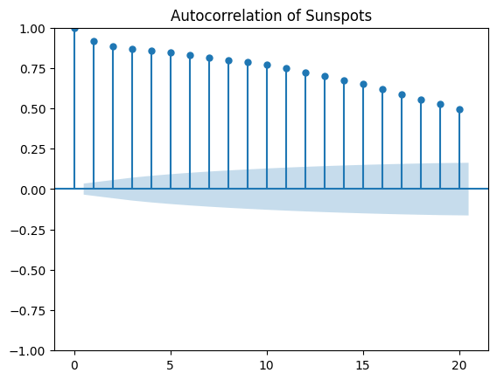
Looking at AR and MA Components
AR order selection [1,2,3,4,16]
MA order selection [1,2,3,4,5]
d order selection [0,1]
Notes:
I choose these values based on the distinct amount of distance away from the confidence interval. I chose the d order since there was no need to difference based on the p-value found from the ADF test which was much lower than the level of significance of 0.05.

Slide 10
ARIMA Selection
Used automated process to select based on the AIC and BIC
Found:
ARIMA (16,0,1)
AIC: 30145.431603
BIC: 30270.160889
Notes:
Used a function created to select the model with the best AIC and BIC based on all possible combinations from the orders in the last slide for p, d, and q.
We will proceed and look at the SARIMA to see how it compares with the ARIMA model selected here.

Slide 11
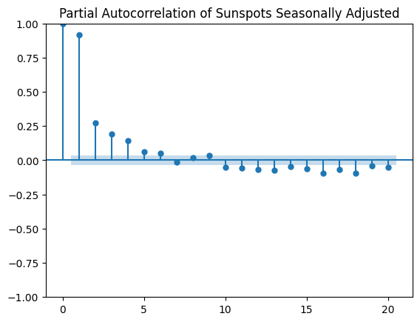
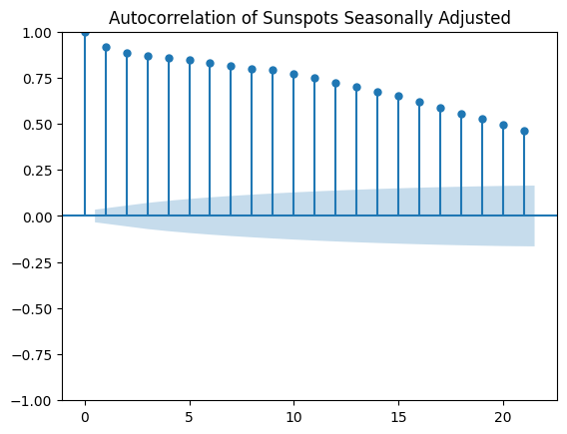
Looking at P,D,Q for removing Seasonality
P (AR) order selection [1,2,3,4,16]
Q (MA) order selection [1,2,3,4,5]
D order selection [0,1]
Notes:
Once again found similar values as that with seasonality. Also, there was once again no need to difference the data, as the p-value was significantly low.
Therefore, I chose these values.

Slide 12
SARIMA Selection
Used automated processes to select based on AIC and BIC
Found:
SARIMA (3,0,2) (0,0,1,12)
AIC: 30181.10394832894
BIC: 30229.83206866262
Notes:
Used a function created to select the model with the best AIC and BIC based on all possible combinations from the orders in the last slide of the big P, D, Q and the seasonal factor of 12 months.
Now, we are going to proceed with the SARIMA model because it appears to have a relatively better AIC and BIC combination.

Slide 13
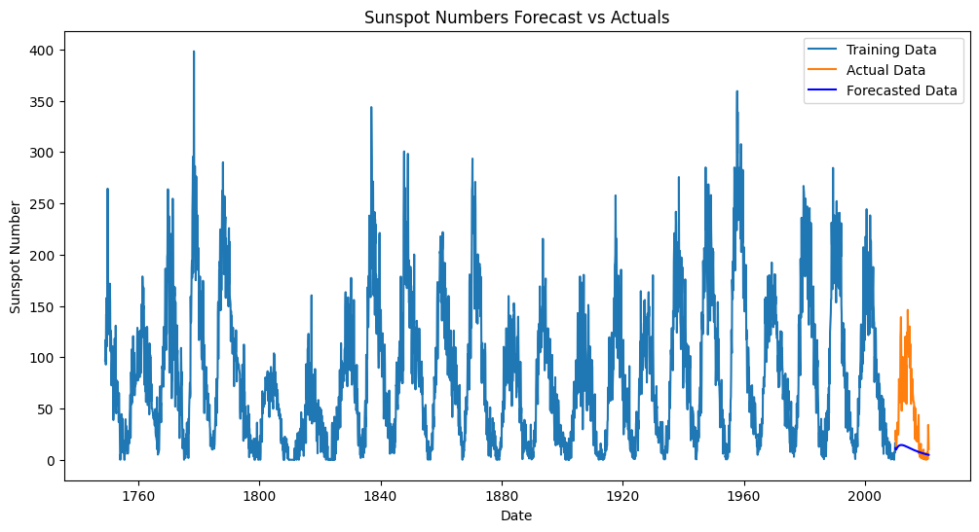
Forecast vs. Actuals using SARIMA
We can see the forecast may have not accurately predicted the complex seasonality and trends in the data.
Notes:
I can see that the forecast doesn’t accurately predict the complex seasonality we expect from the data in the 11 year solar cycle. Therefore, I conclude that this model doesn’t effectively forecast for the data. So, I will proceed to look at other models that may be more efficient for the dataset.

Slide 14
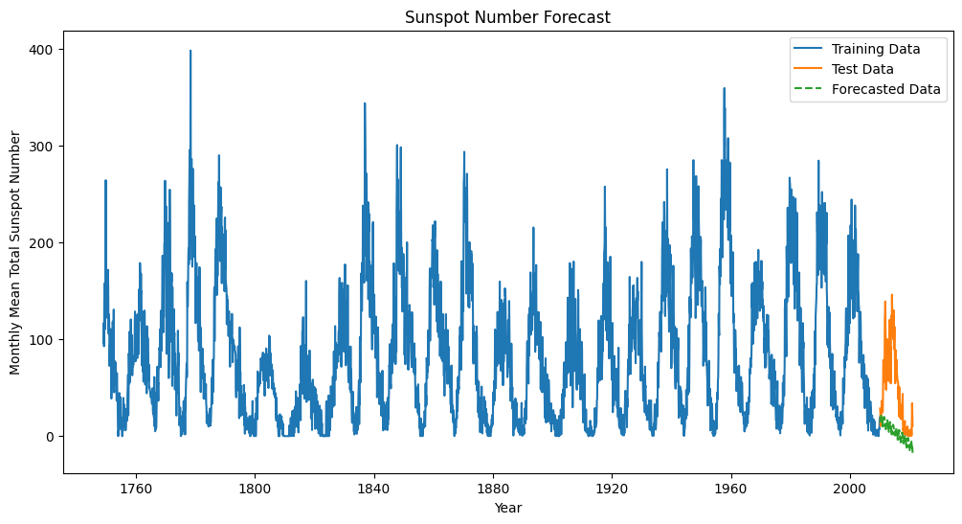
Using Holt’s Winters Method
Notes:
I split the data into the last 132 months for testing and did the training on the other parts of the data. The graph above shows the general prediction. Once again, this graph doesn’t accurately represent the data well. It appears to get the general trend potentially, but not the seasonality incorporation we would hope for. I believe this is due to the larger dataset and the larger amount of variance as we forecast the future.

Slide 15
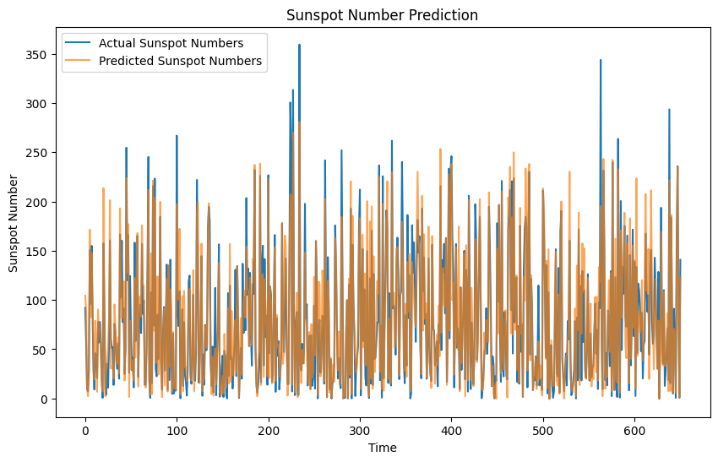
Using Neural Networks
Notes:
For this model, the predictions actually follow the general trend of the actual data. This indicates that the neural network has learned the cyclic nature of sunspot activity to some extent. However, the alignment is not precise in terms of timing and magnitude of the peaks and troughs.
Also, the predicted values generally have lower amplitudes compared to the actual values, especially noticeable during peak sunspot periods. This suggests that the neural network model might be underestimating the maximum sunspot numbers during peak periods.
Lastly, the frequency of the predicted cycles seems to match reasonably well with the actual data, but there might be a slight phase shift in some sections where the predicted values lag or lead the actual observations.

Slide 16

Cross Validation of Neural Network
Average MSE: 0.003776115895043971
Average RMSE: 0.06127926364414369
Notes:
The low MSE and RMSE values across multiple splits imply that your model generalizes well over different subsets of the data. This indicates consistent performance and suggests that the model is not overly fitted to a specific part of the dataset.
Also, there is low variance in predictions across different time splits that indicates model stability. This is a good sign that the model's predictions are reliable across time.
Lastly, the errors appear to be minor relative to the scale of sunspot number values.

Slide 17
Conclusion
Improvement Opportunities:
Increasing Model Complexity: Adding more LSTM layers or neurons, or adjusting the model architecture (e.g., more dense layers, dropout for regularization).
Feature Engineering: Including additional features that might help predict sunspot numbers, such as prior cycle lengths or other solar activity indicators.
Hyperparameter Tuning: Experimenting with different learning rates, number of epochs, or batch sizes.
Data Augmentation: Increasing the dataset size or using data augmentation techniques to provide more training examples.
Notes:
Overall, I found multiple areas of improvement for the dataset analysis. However, it was great to see how well the neural network predicted the data. While, the ARIMA, SARIMA, and Holt’s Winters methods weren’t as accurate. This makes sense due to the large scale of data.

